Slide 1



Employee Insights
View in Power BI
Last data refresh:
1/20/2023 9:15:50 PM UTC
Downloaded at:
1/20/2023 9:20:15 PM UTC

Slide 2
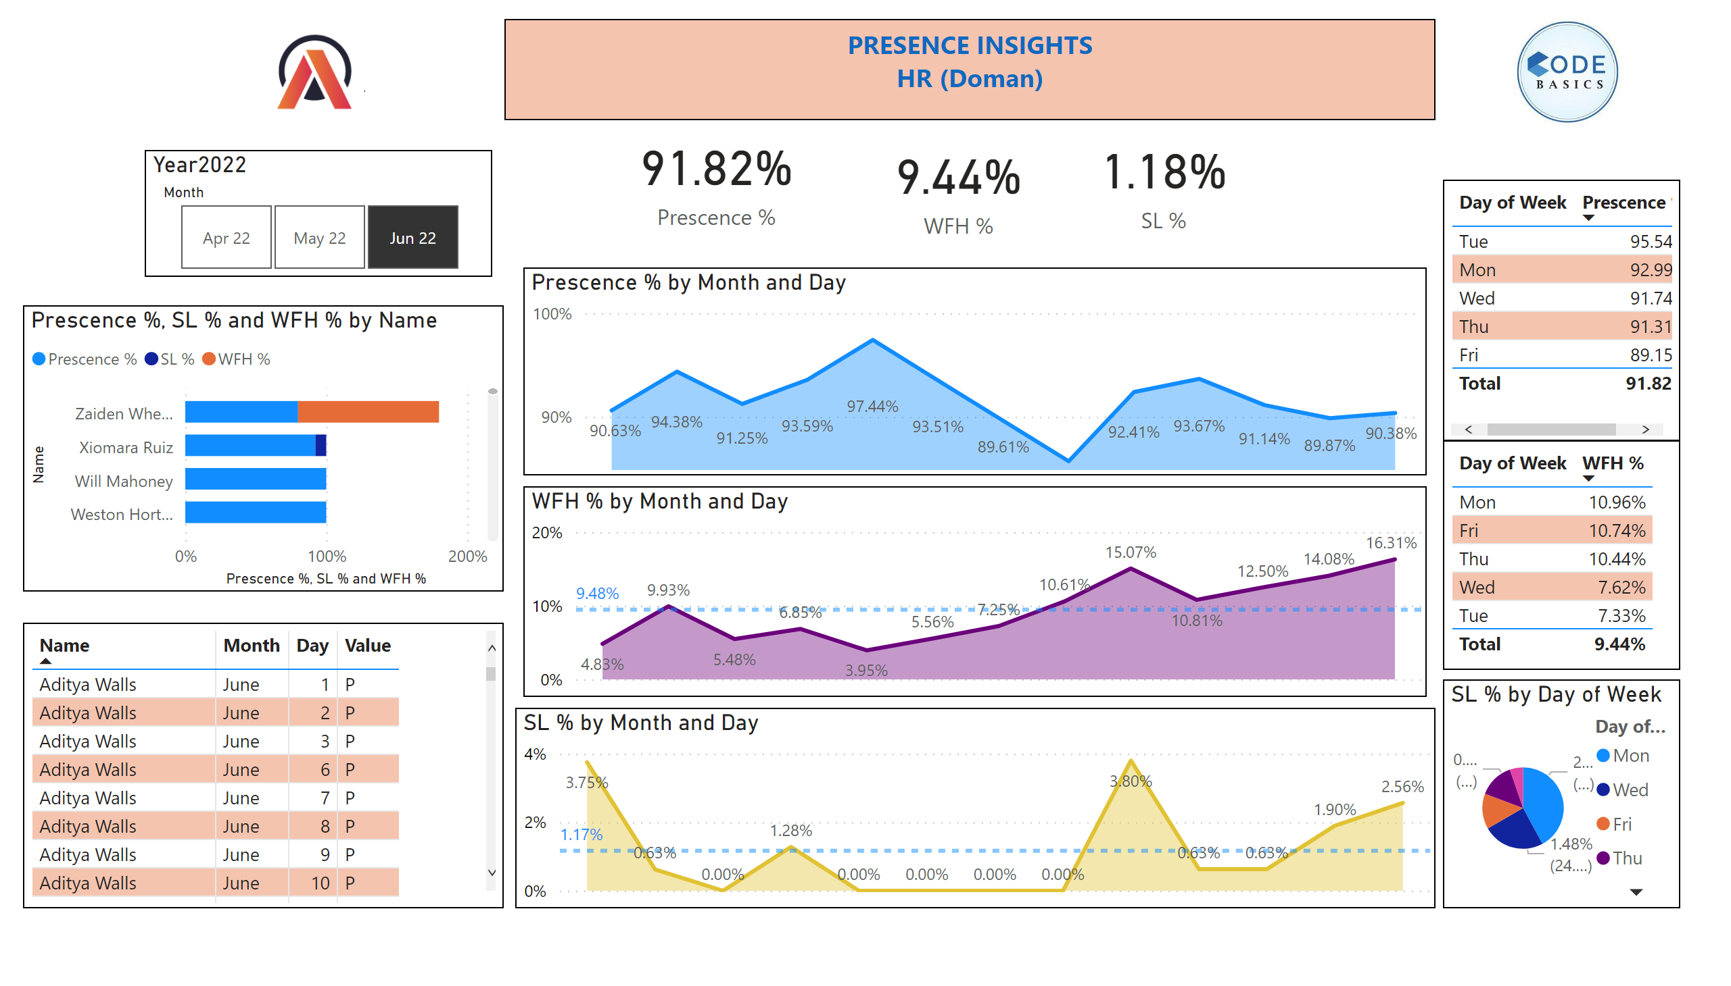
Employee Presence Analysis
Notes:
card
No alt text provided
card
No alt text provided
card
No alt text provided
barChart
No alt text provided
textbox
No alt text provided
tableEx
No alt text provided
stackedAreaChart
No alt text provided
areaChart
No alt text provided
areaChart
No alt text provided
tableEx
No alt text provided
tableEx
No alt text provided
pieChart
No alt text provided
Year2022
No alt text provided
image
No alt text provided
image
No alt text provided

